Slide 1
UNIT 2: ANCIENT EGYPT

Slide 2
Warm Up
Complete the Think/Pair/Share Activity on Ancient Egypt
What do you already know about Ancient Egypt? What do you expect to learn in this unit?

Slide 3
Chronology and Ancient Egypt
The order in which things happened
Egypt can be studied in three dynasties (kingdoms) → When dynasties had strong control throughout Egypt
The Old Kingdom
The Middle Kingdom
The New Kingdom
And three intermediate periods
Egypts main government was weak and unable to control its economic resources
Local rulers were more powerful and often competed with one another
Egypt might have been threatened by outside powers

Slide 4
Timeline Activity
Analyze “Source 1: Timeline showing the main dates and periods in the chronology of ancient Egypt”
Complete the worksheet

Slide 5
Physical Features

Slide 6
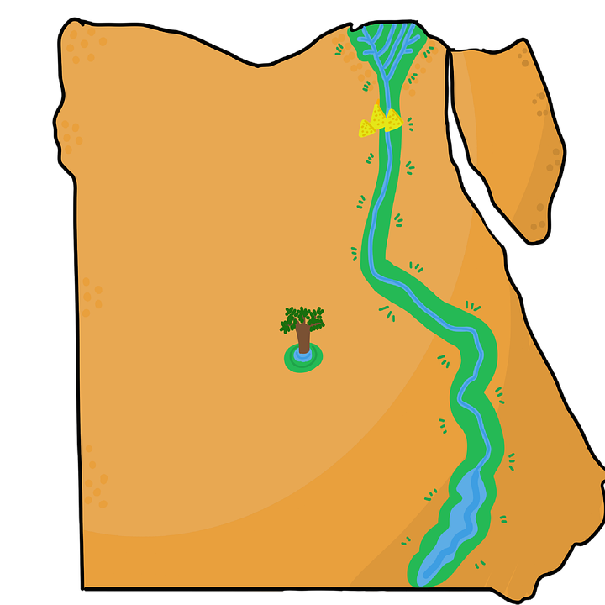
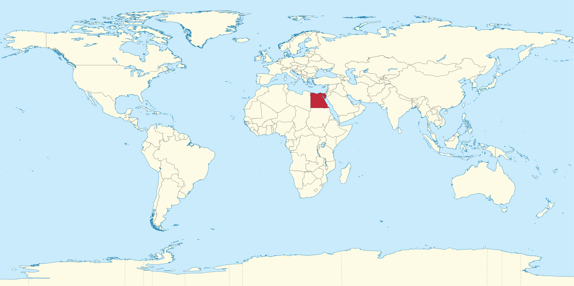
Checkpoint
What are the benefits to Egypt’s physical location?
Why?

Slide 7
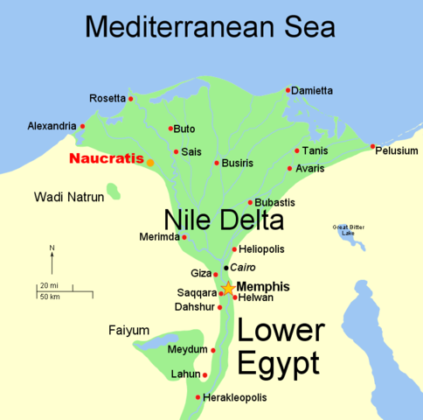
The Nile
A river in Egypt; the longest in the world
Flows from one end of Egypt to the other
Main form of transportation and communication
Pyramid and temple builders would send huge flat barges to transport stone from quarries to building sites
Cargo boats carried grain and other supplies
Used for fishing

Slide 8
The Nile Floods
Flooded every year from torrential rains
By summer the floodwaters reached Egypt’s First Cataract → a waterfall forming the geographical boundary that marked the beginning of the Nile River valley and the area known as Upper Egypt

Slide 9
Nile Floods Continued:
The floodwaters left behind thick layers of mud that created fertile farming land for planting grain → the “Black Lands”
The rest of Egypt was desert and known as “Red Lands”
This separated Egypt from its neighbours and protected it from enemy invasions

Slide 10
Warm Up
What role did geography play in ancient Egypt? (Think back to what we discussed yesterday)

Slide 11
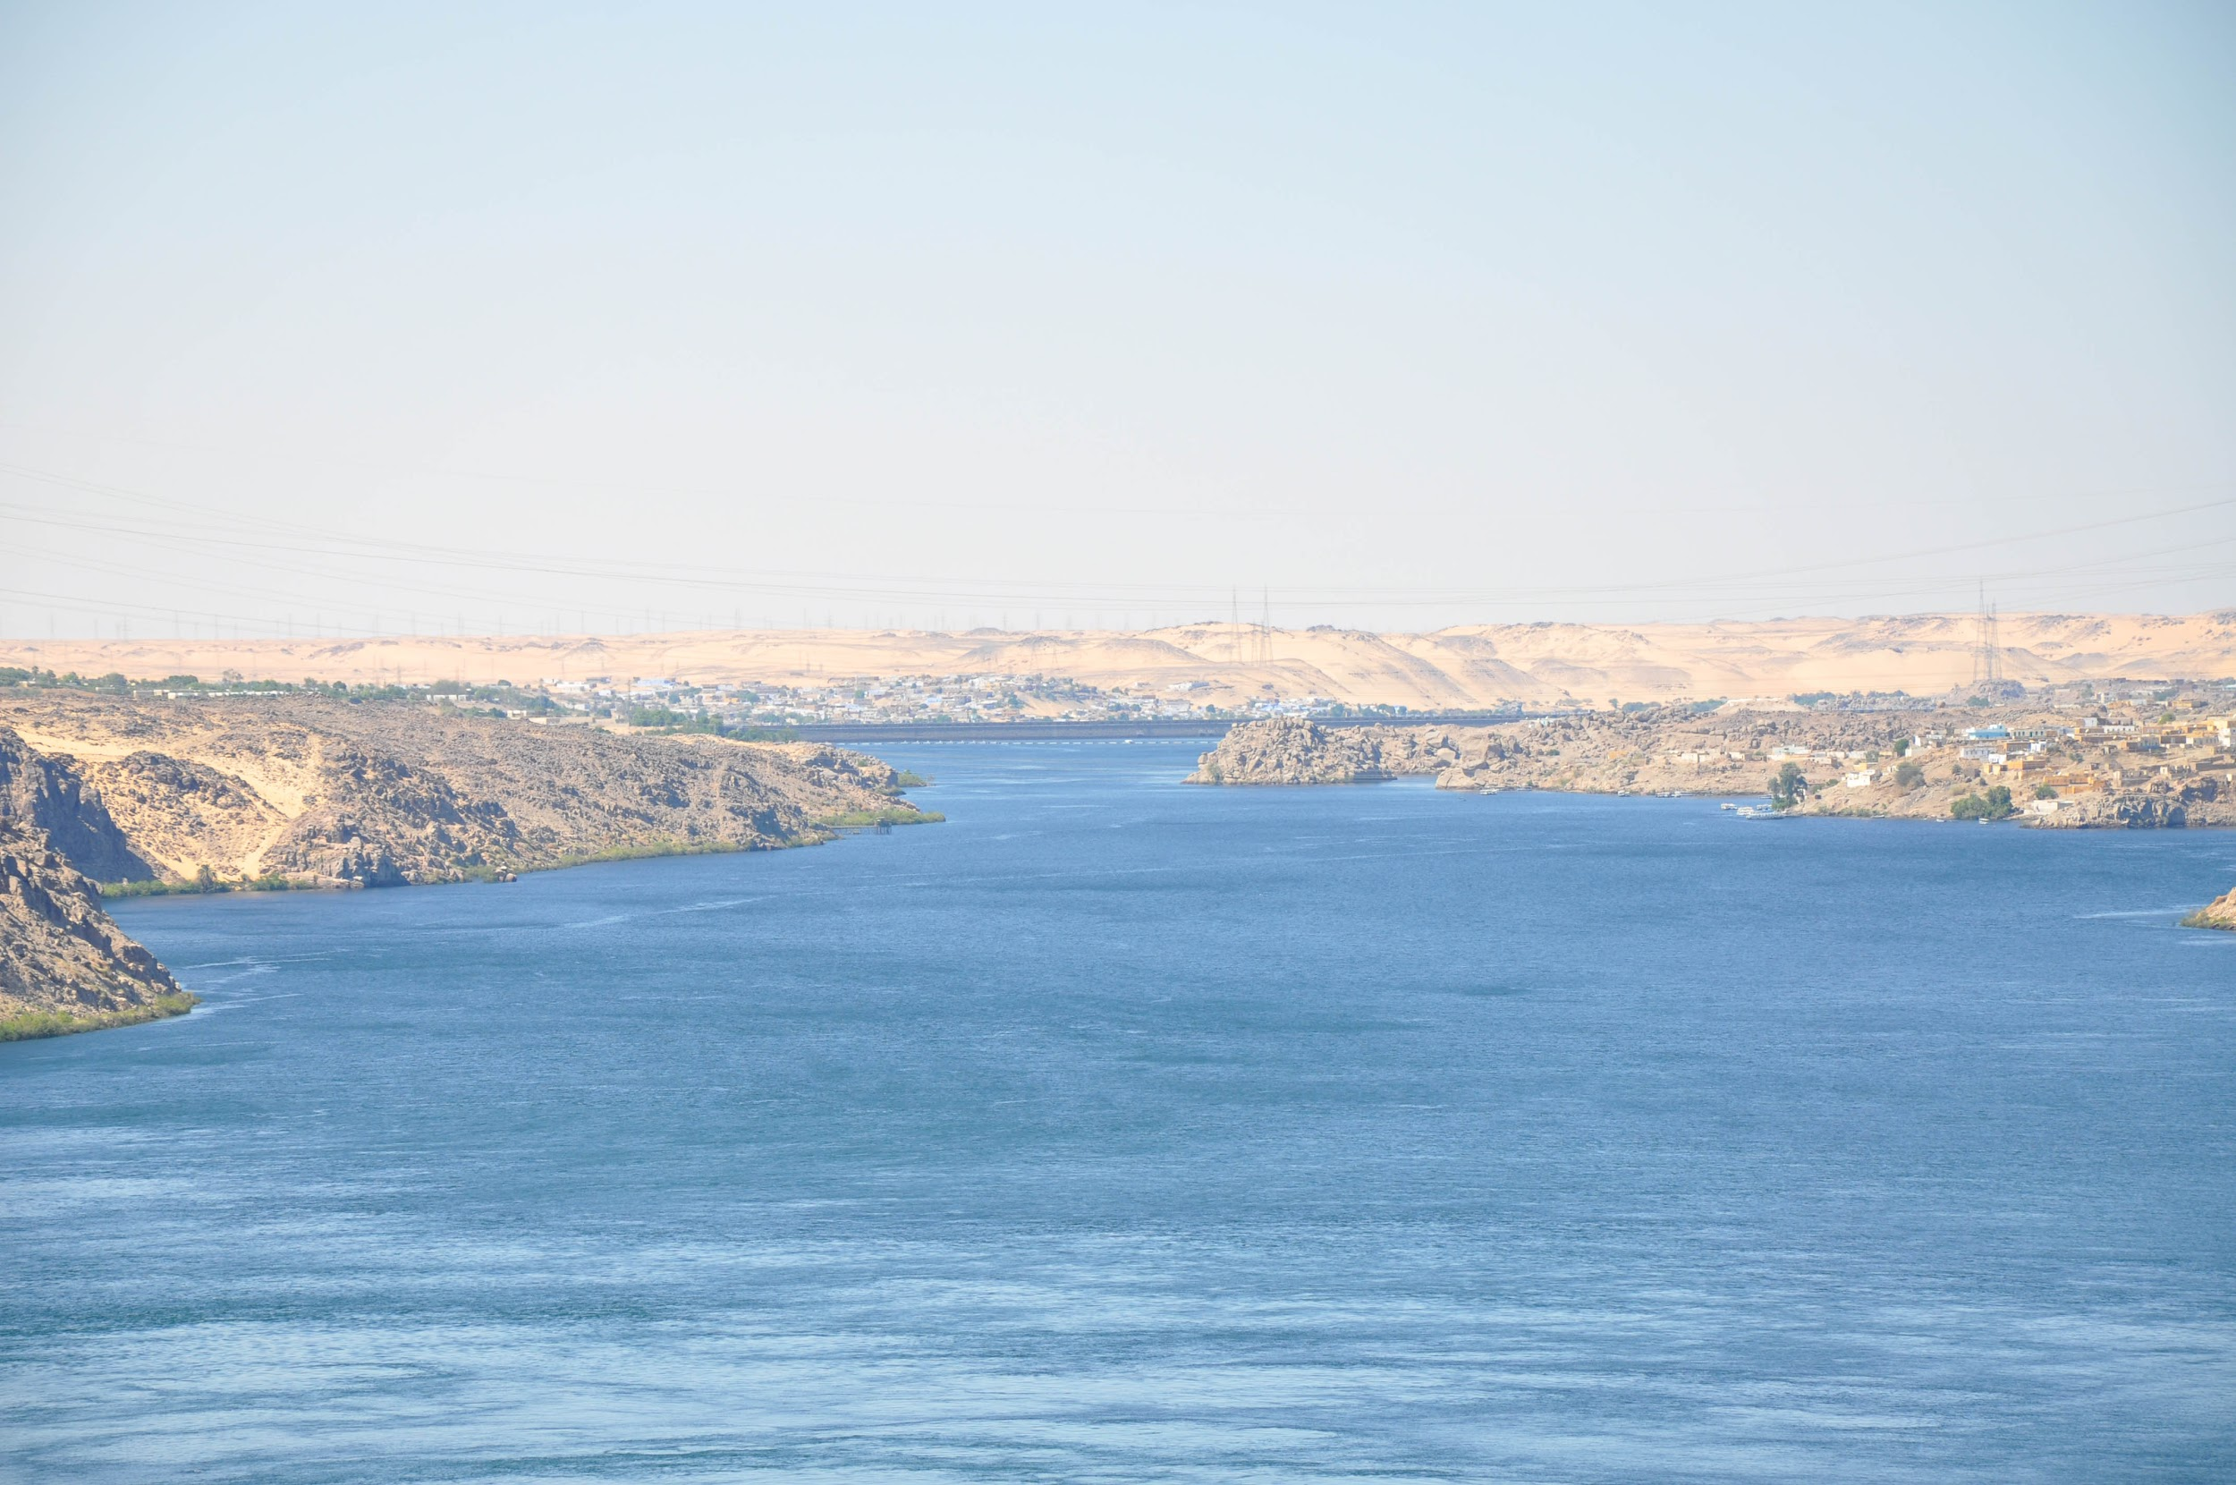
Nile Floods Continued
The rise and fall of the Nile created three distinct seasons
Akhet - flood season
Peret - seed time
Shemu - harvest time
Impact of the flood
Created fertile crop growing areas
Too big would destroy property
Too small wouldn’t produce food

Slide 12
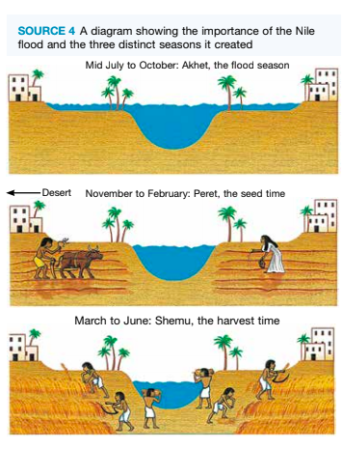
Importance of the Flood

Slide 13
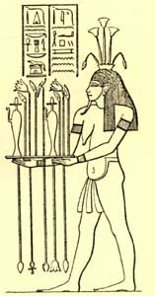
Hapi - god of the Nile flood
God of the flood
Associated with signs of fertility, such as vegetation, fish and birds
People built many temples to Hapi

Slide 14
Exit Ticket
What are the important physical features of ancient Egypt? Why?

Slide 15
Organisation of Society

Slide 16
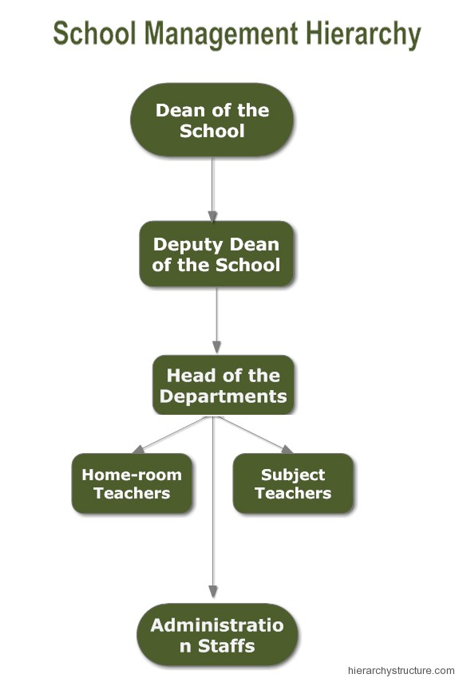
Exit Ticket
What is a hierarchy? Give an example? What is this an example of?

Slide 17
Pharaoh’s Worksheet
Directions: Read pages 79 – 81 about pharaohs and the law in ancient Egypt and answer the questions on the worksheet

Slide 18
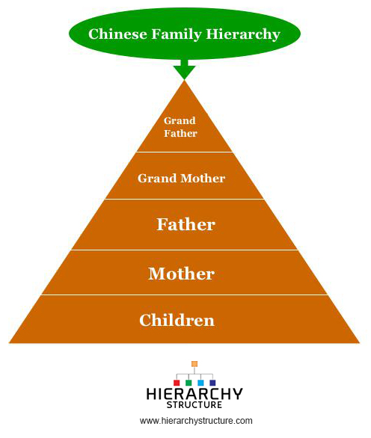
Warm Up
What is this an image of?
How does your family fit in?
Draw your family hierarchy

Slide 19
Worksheet Answers:
Pharaohs
Women ruled only if she was a close relative of the previous pharaoh and the heir was too young to rule in his own right
Ex: Hatshepsut
People viewed the pharaoh as a god, their protector, and their leader in battle
People expected the pharaoh to make sure the Nile flooded, people had enough food to eat, and to defend Egypt and rule the army
Ma’at = truth (heart of Egyptian life)
The pharaoh brought truth and justice to the world

Slide 20
Worksheet Answers Continued
7. In theory men and women were considered equal because the law gave both men and women essentially the same legal status and economic rights. For example, both women and men could purchase and sell land. This shows that they were essentially equal in society.
8. Slaves in ancient Egypt had more rights than in other ancient societies. For example, they became slaves because they owed money and once they were able to pay it they became free again
9. The pharaoh has so many wives so they could pass down property and wealth to other members of their family and keep the bloodline pure.

Slide 21
Worksheet Continued
10. The biggest influence in ancient Egyptian society was….

Slide 22
Roles in society
Pharaoh – the most important role
Vizier – chief judge and in charge of the government
Nomarchs (governors) – responsible for ruling their region (nome)
Officials – maintain law and order, record the pharaoh's decisions and collect taxes
Priests and priestesses – supervised religious practices
Scribes and artisans – studied language and writing and kept all records
Farmers, fishermen and other labourers
Servants and slave status

Slide 23
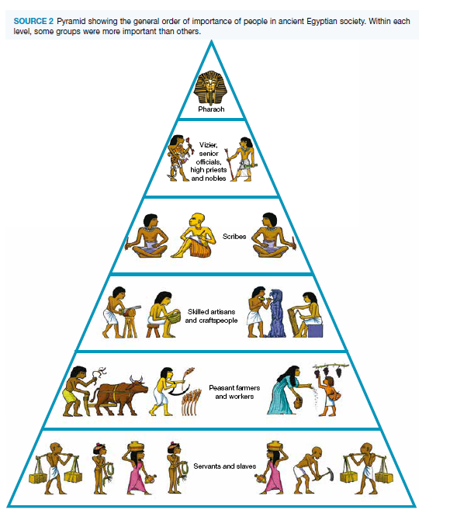
Roles in Society

Slide 24
Roles of key groups
Compare and contrast the key groups in ancient Egypt with those in ancient Greece
Complete the graphic organizer
Use textbook page 83 and the Internet

Slide 25
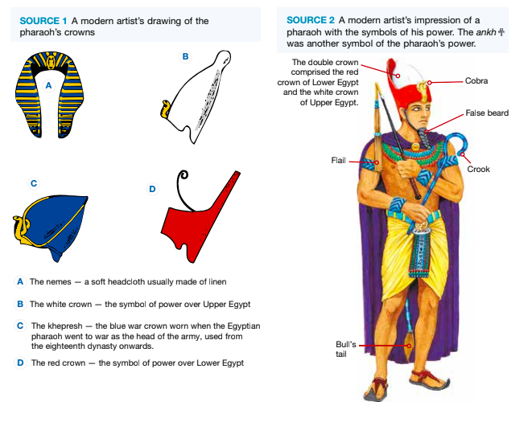
Warm Up
What can we learn about pharaohs from this image?

Slide 26
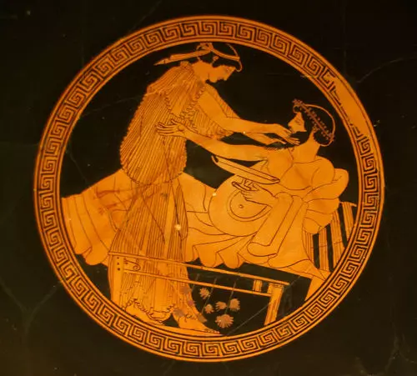
Women
Ancient Egypt
Ancient Greece
Birth of a girl was valued
Respect for female goddesses - women share the same qualities as the female gods
Responsible for the home and child-rearing
Legal right to work and own property
Limited in the kinds of work they could do
Birth of a girl was a disappointment
No political rights
Most important responsibility was child-bearing and rearing
Could not vote or own land

Slide 27
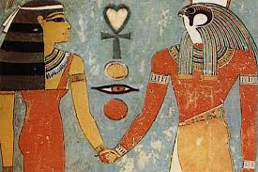
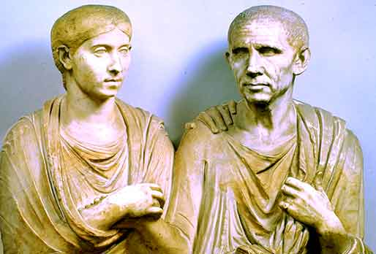
Family Life
Ancient Egypt
Ancient Greece
Arranged marriages but no formal ceremony
Girls married at age 12
Boys married at age 15
Divorce was expensive but possible
Arranged marriages
Boys went to school from age 7 - 14 (girls did not)
Girls married from 14-18
Boys married from 20-30

Slide 28
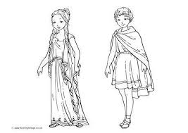
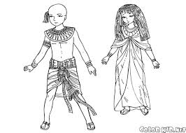
Children
Ancient Egypt
Ancient Greece
Children began working at age 8
Learn a trade or become involved in farm work
Boys took after their fathers
Children help support the families
Not many opportunities to learn to read and write
Children spent the majority of their time with their mother
Girls were educated at home
Boys joined their fathers trade or went to school at age 7

Slide 29
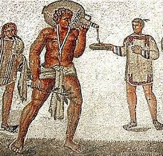
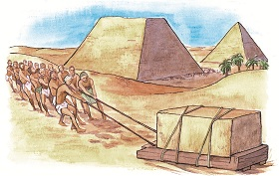
Slaves
Ancient Egypt
Ancient Greece
Used as labour - to build pyramids
Either criminals, those who could not pay their debts, or captives from foreign military campaigns
Used as labour
Ways to become a slave:
They could be enemy soldiers captured in war.
They could be captured by pirates and sold into slavery.
They could be born into slavery

Slide 30
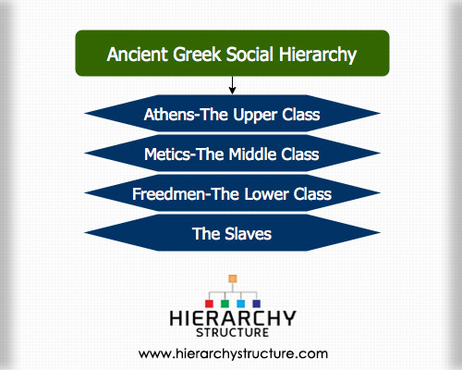
Citizens
Ancient Egypt
Ancient Greece
Divided into social classes
Could not move classes
Either a free man, foreigner, or slave
Divided into social classes

Slide 31
Nobility
Ancient Egypt
Ancient Greece
The pharaoh was the connection between the gods and the people
The pharaoh “enjoyed great wealth and status”
Aristocracy - the highest class in certain societies, typically comprising people of noble birth holding hereditary titles and offices

Slide 32
Ancient Greece Hierarchy
Upper class- managed the government and administrative work, literary work, and the military, and owned slaves
The middle class - free men but did not have as much freedom as upper class. Mostly worked as traders in other businesses
Freedmen (lower class) - Men that were once slaves but now free; they could never become citizens
Slaves - Forced to work for free and treated terribly

Slide 33
Ancient Greece Hierarchy
How does this hierarchy compare with ancient Egypt? Explain. Give examples

Slide 34
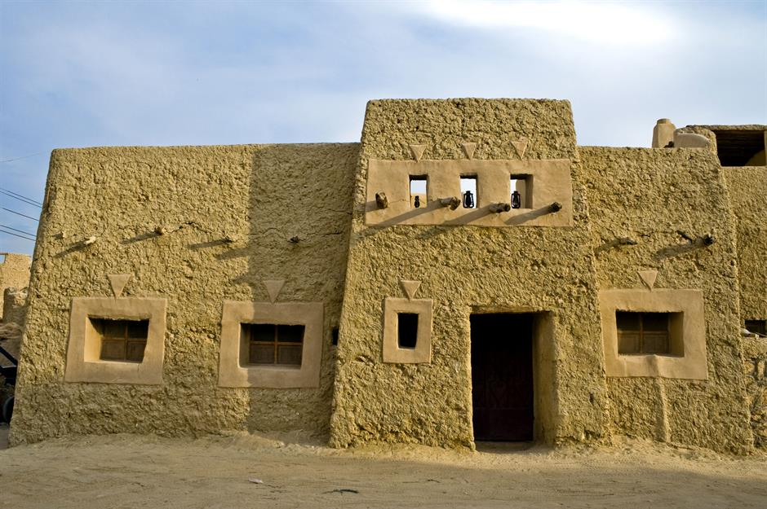
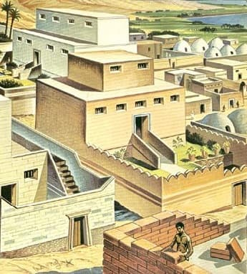
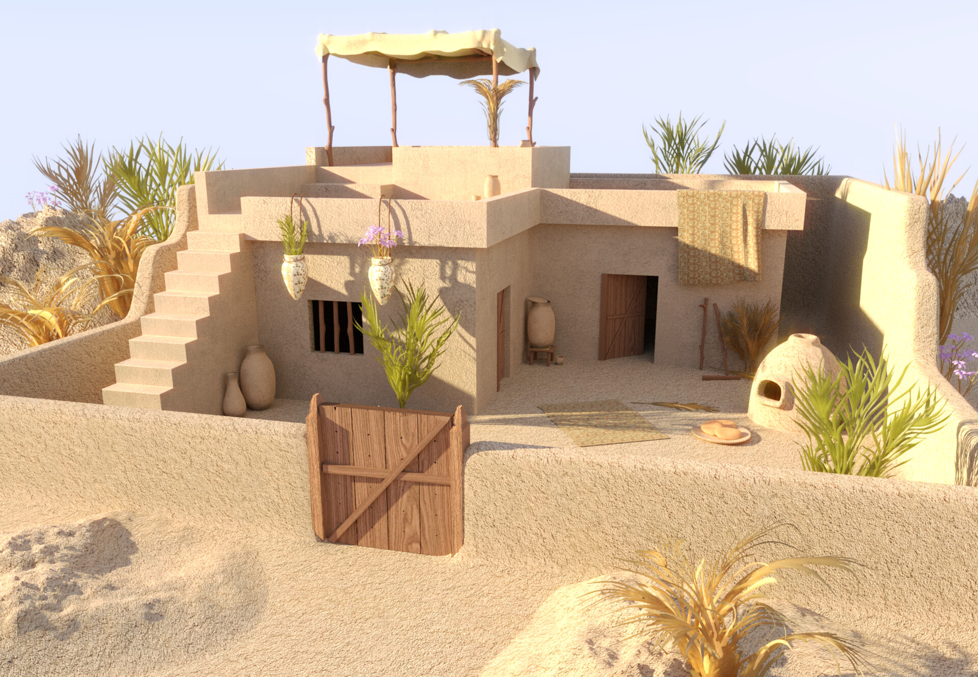
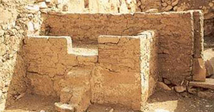
Warm Up
What do you notice about these images?

Slide 35
Housing
Analyze the source in this document and answer the questions that follow in order to learn about housing in ancient Egypt

Slide 36
Housing
Built towns and villages on high ground
Used sun-dried mud bricks mixed with straw
Houses designed to cope with the hot climate:
Flat roofs with vents to let the breeze in
Kitchen at the top floor for the cool air
Roofs with terraces to sleep outside
Window openings were small to minimize the impact of heat and glare

Slide 37
Wealthy houses
Large two-storey houses with thick exterior walls covered in white limestone plaster to reflect heat
Had decorative frescoes – paintings on plaster walls or ceilings
Beautiful gardens and pools outside surrounded by a high wall for privacy

Slide 38
Ordinary people's houses
Clay
A living/eating areas that could become a sleeping area at night
Another separate sleeping area
Storage areas for grain and beer
Often an outside staircase that led up to a terrace on the flat roof

Slide 39
Farming:
Wheat
Barely
Flax
Beans
Cucumbers
Leeks
Figs
Pomegranates
Sheep
Oxen
Cattle
Geese
Ducks
Pigs
Goats
Began when the flood receded
Irrigation channels dug between each field
Directed excess water into channels to use when needed
Tax officials came by to collect half of what was grown
Number of animals owned was a sign of wealth
Fertile farmland allowed for trade

Slide 40
Work in towns:
Women worked mainly as stallholders in the marketplace
Some people worked in the pharaoh’s palace workshop or offices or one of his huge building sites
Others worked outdoors, in local workshops, or in their own homes
Scribes were a highly sought after job but only available to those who were sons of scribes
Brewers
Builders
Coppersmiths
Doctors
Goldsmiths
Jewelers
Metalworkers
Paper makers
Potters
Sandal makers
Stonemasons
Weavers
Wig makers
Woodworkers

Slide 41

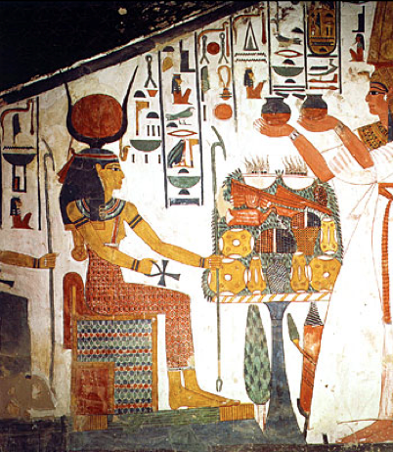
Artists and sculptors
Main features of Egyptian art:
Most important people were the largest
Bodies with eyes and upper body facing the front
Showing the head, arms, and lower body side on
Left leg in front of the right

Slide 42
Building work
Building grand temples and monuments was an important part of ancient Egyptian culture
By filling buildings with rubble after constructing each layer of a wall or pillar, they created an area from which people could work on the next stage
They worked upwards during the construction phase and downwards during the decoration phase

Slide 43
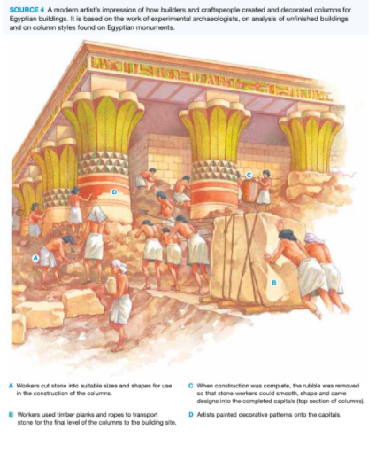

Slide 44
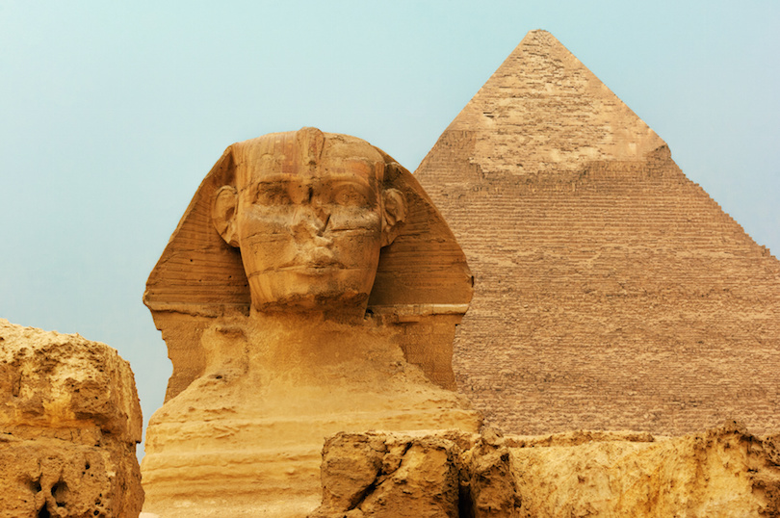
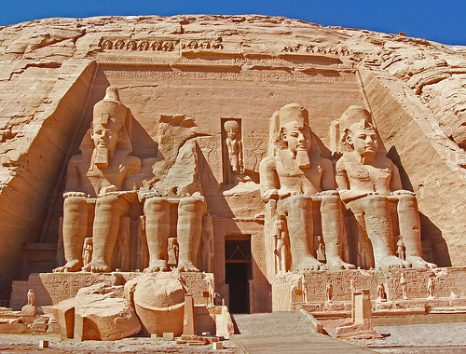
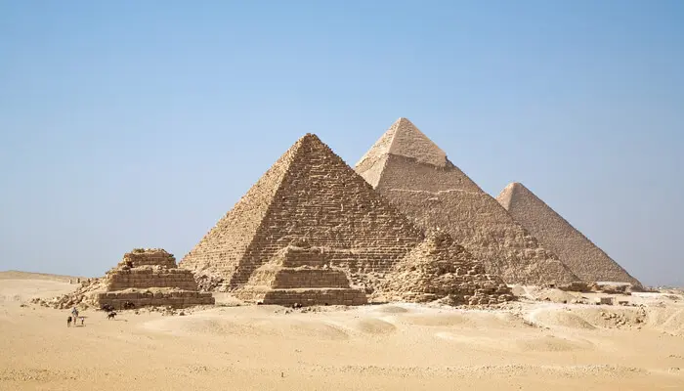
Warm Up
What can we learn about Egyptian religion from these images?

Slide 45
Religion Reading and Peer Edit
Read pages 89 - 91 in your textbook and answer the questions on the worksheet
Make sure for #1 you OUTLINE
Make sure for #2 you DESCRIBE
Complete the Peer Edit review form
Read your partner’s response
Complete this worksheet
Give back to partner

Slide 46
Outline the relationship ancient Egyptians had with their gods
Saw signs of gods all around them
Gods controlled everyday life and the afterlife
They had to please the gods or the gods would turn the world into nothingness again
Often represented as animals
Every city or village worshiped a specific god
Stories about the gods explained mysteries
Festivals and holidays were spent worshipping the gods

Slide 47
Exit Ticket
What role did religion play in ancient Egypt? CITE EVIDENCE!

Slide 48
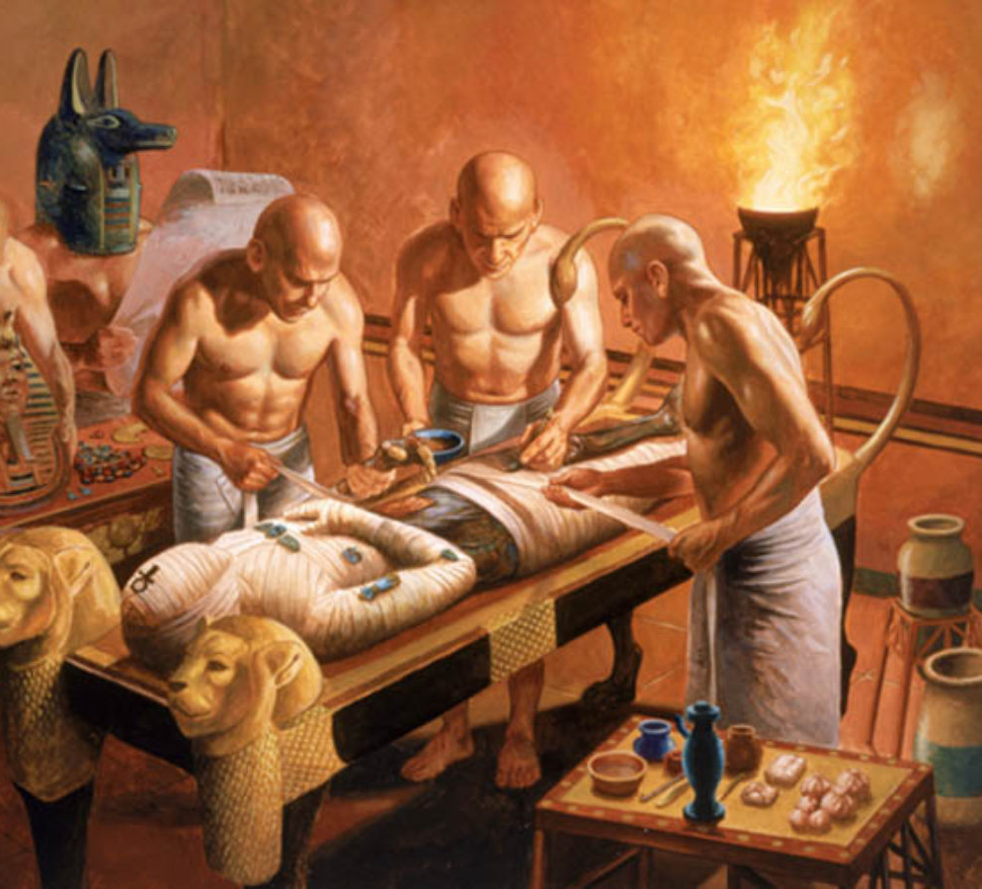
Warm Up
What does the mummification process tell you about how Egyptians viewed the afterlife? Why? Explain

Slide 49
Funerary customs

Slide 50
Embalming and mummification
Egyptians believed that properly preparing a body so that it could live on in similar way in the afterlife
The body had to be preserved. Someone had to:
Prepare the body so that Ba, the bird representing the person’s spirit, could still recognise it and reunite with it before journeying to the afterlife
Ensure Ka, the person’s life energy, would have food and drink for the next life
Arrange for some of the dead person’s possessions to accompany the preserved body
This process was different depending on your wealth
Poor families buried their loved ones in the desert sand

Slide 51
Mummification
https://www.youtube.com/watch?v=4FiM8S2_nSg

Slide 52
Exit Ticket
What does mummification tell you about life in Egypt

Slide 53
Source Analysis
Read Sources 1 and 2 provided
Complete the APPARTS document for source analysis

Slide 54
Warm Up
What practices did ancient Egyptians participate in? Why?

Slide 55
Go over responses:

Slide 56
Outline the relationship ancient Egyptians had with their gods
Saw signs of gods all around them
Gods controlled everyday life and the afterlife
They had to please the gods or the gods would turn the world into nothingness again
Often represented as animals
Every city or village worshiped a specific god
Stories about the gods explained mysteries
Festivals and holidays were spent worshipping the gods

Slide 57
Describe TWO practices:

Slide 58
Animal Worship:
Believed that the gods appeared in real life n the form of animals
Ex:
Falcons = Horus
Baboons and ibises = Thoth
A person could be condemned to death if they killed an animal on purpose
Cats represented the gods Bastet and Pakhet
Many cat owners mummified their pets

Slide 59
Festivals
https://www.youtube.com/watch?v=DFEs8CA15Ug

Slide 60
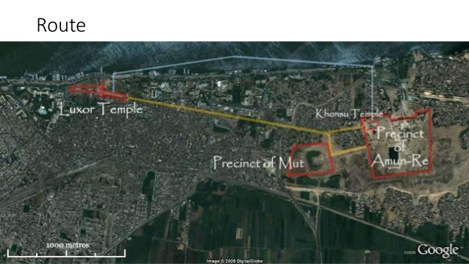
The Beautiful Feast of Opet
Took place during the flood season
Lasted from 11 - 27 days depending on the year (and pharaoh)
Procession (like a parade) where the pharaoh, high priests, and important officials accompanied the statues of Amun Re, his wife and son on a river journey from the temple at Karnak to the temple at Luxor and back
Symbolised renewal of the land, the power of the gods, and Amun Re’s approval of the pharaoh

Slide 61
The Beautiful Feast of the Valley
Took place during Shemu, the harvest season
Priests took images of Amun-Re and Mut to their son Khonsu across the Nike from Karnak to Thebes
Here the gods visited the temples and shrines of the dead

Slide 62
Checkpoint
How do holidays or festivals you celebrate differ from those in ancient Egypt?

Slide 63
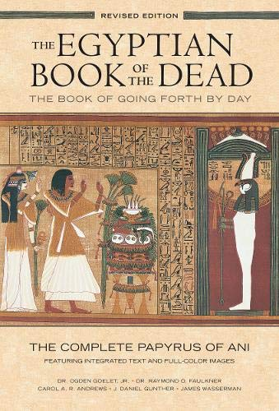
Judgement and the afterlife
The Egyptian Book of the Dead contains papyrus scrolls containing more than 200 spells
Spells were like good wishes or prayers to help the deceased person survive the journey to the afterlife
They believed this journey was full of danger

Slide 64
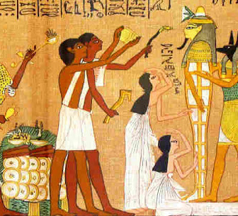
“Opening of the mouth”
An important part of the ceremony conducted by the priest
Coffin placed in upright position
Priest touched the ears, eyes, mouth, nose, legs and arms of the image painted on it
This freed the person’s senses so that he or she would be able to hear, see, breathe, speak, smell and generally come to life again

Slide 65
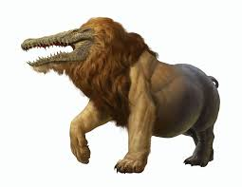
“Weighing of the heart”
The most important test in the journey to the afterlife
Held in the Hall of Two Truths
People believed that the gods put the dead person’s heart on a balance and weighed it against the feather representing Ma’at, the goddess of justice
The heart had to weigh less than the feather to allow the person to the afterlife
If the heart was heavier then it would be sent to be eaten by the monster Ammit, or “bone-eater

Slide 66
Weighing of the Heart
https://www.youtube.com/watch?v=1yv_MXNYbAo

Slide 67
Exit Ticket
How did ancient Egyptians show their appreciation for the dead? Write about one practice or ritual

Slide 68
Warm Up
Why do you think the ancient Egyptians built the pyramids?

Slide 69
PYRAMIDS AT GIZA

Slide 70
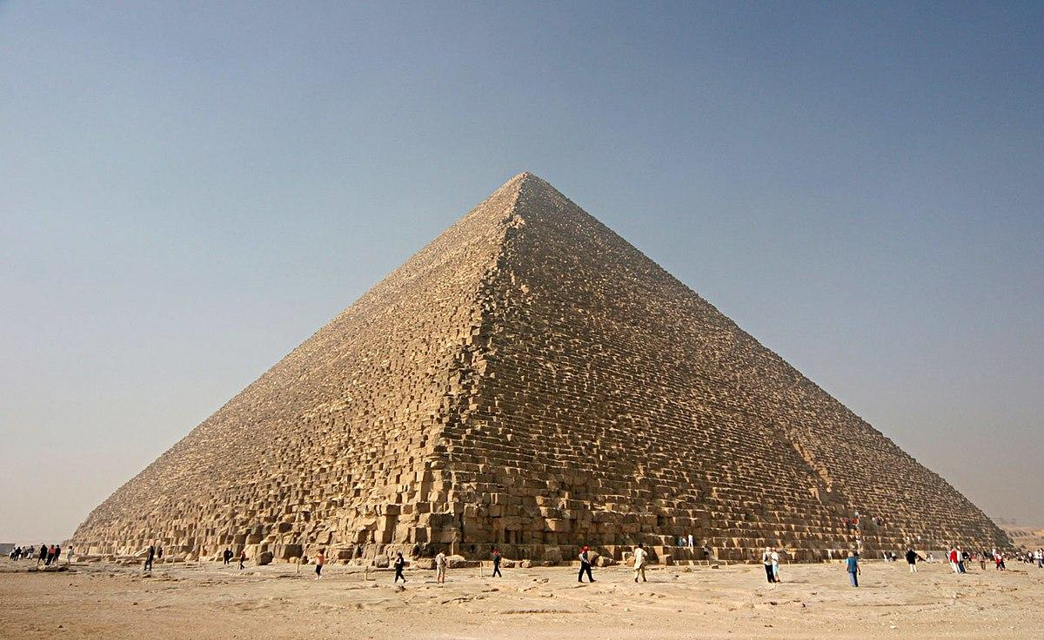
KHUFU’S GREAT PYRAMID
One of the seven wonders of the world
Constructed during the third and fourth dynasties

Slide 71
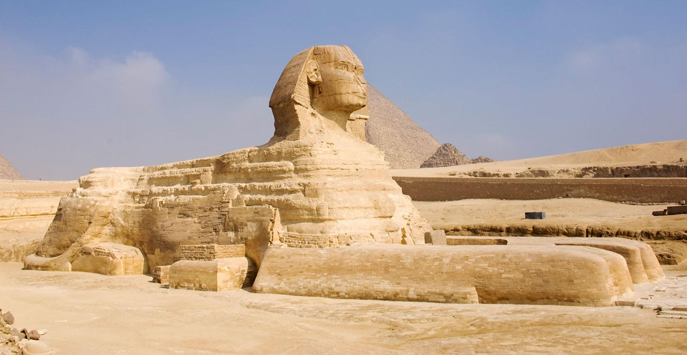
BUILDING TECHNIQUES
The use of cut stone as the main building material
Thick, inwardly sloping walls with few openings, which made buildings more stable
Carved painted and sculpted decoration on walls
The use of columns to provide support

Slide 72
WHY THEY WERE BUILT
Built as tombs to protect the mummified bodies of the pharaohs
Other hypotheses:
Created as an observatory
Code for predicting the future

Slide 73
Writing Practice:
Use the guidelines to answer the writing task

Slide 74
Warm Up
Write a C-E-R on the following question:
What is the best food to eat in the morning?
Remember…. Write a claim (statement - thesis) then cite evidence (an example) and then connect them (because)

Slide 75
Peer Edit
Take out the writing practice from last class
Peer edit with TWO people next to you
Read responses
Turn in

Slide 76
Practice Outlining
Read the text provided and OUTLINE the main ideas

Slide 77
CERC Writing Feedback:
Claim → Should be clear and specific. Make a statement that can be proven. Be specific!!
Example: Joseph, Noa-Rose, Meron
Evidence → Cite the exact quote and introduce it. “For example in source 1…..”
Example: Nayan, Ella
Reasoning/Analysis → Explain how the quote proves the point. Connect it back
Example: Luca, Chloe, Zara, Tom

Slide 78
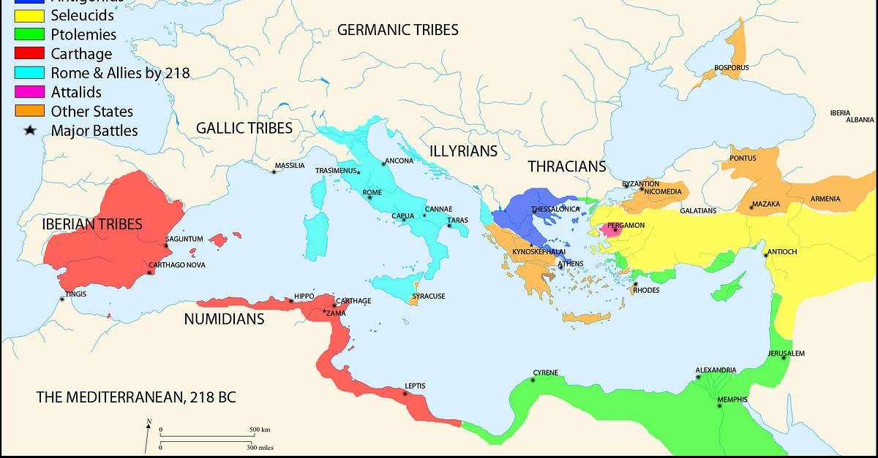
Warm Up
Examine the map
What threats did ancient Egypt face? Why?

Slide 79
WAR, EXPANSION, AND INVASION
Reading Worksheet

Slide 80
Video

Slide 81
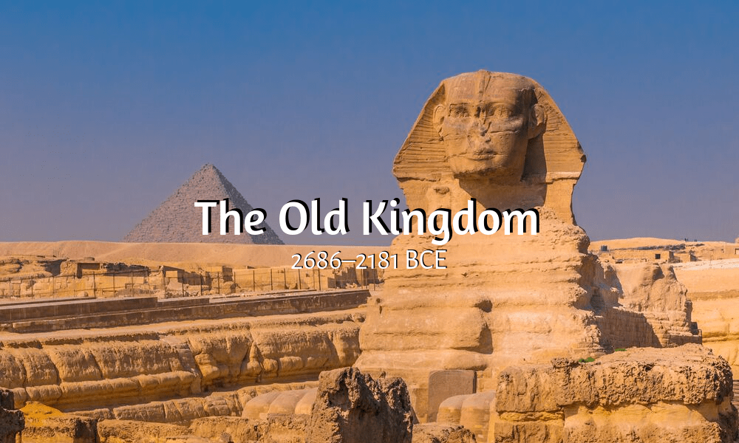
The Old Kingdom
Pharaohs established a strong central government
Profitable trade with Nubia, Towards the end of the Old Kingdom, Egypt began a military campaign into Libya
After the civil war of the First Intermediate period, pharaoh Mentuhotep reunited Egypt and began the Middle Kingdom period

Slide 82
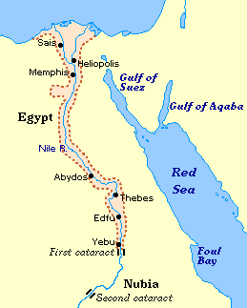
OLD KINGDOM POWER

Slide 83
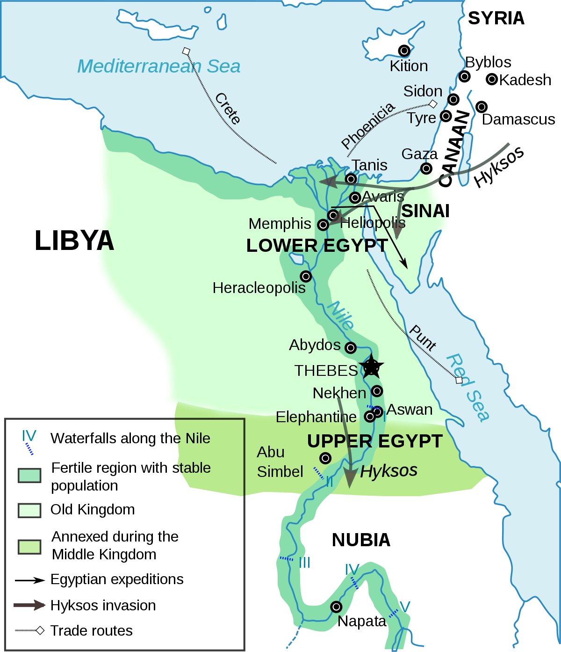
The Middle Kingdom
From the time of pharaoh Amenemhet I, Egypt began to reassert its power.
Expanded its borders into northern Nubia
Established forts along the Nile
Created a good relationship with the Nubians – allowing them to maintain control of resources in the desert
Egypt’s wealth and good supply of natural resources made it a target for other countries

Slide 84
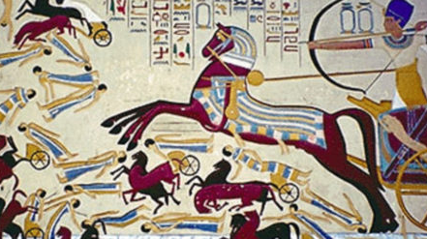
The Hyksos
In 1650 BCE the Hyksos migrated into and gained control of the Nile delta
This led to instability in the Second Intermediate period
Egyptians continued to rule from Thebes
Hyksos rulers governed Egypt’s north from their capital at Avaris
The Hyksos had better weapons – wore armour, rode horses, used swords
Egyptians – used axes, bows and arrows, daggers, slings and spears
Forced the Egyptians to improve their military tactics
Egyptians won back control when pharaoh Ahmose I beat the Hyksos (starting the New Kingdom era)

Slide 85
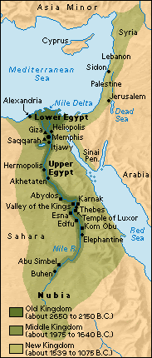
The New Kingdom
“golden age”
Empire extended into Palestine, southern Nubia and parts of Syria
Developed Egypt’s trading relationships

Slide 86
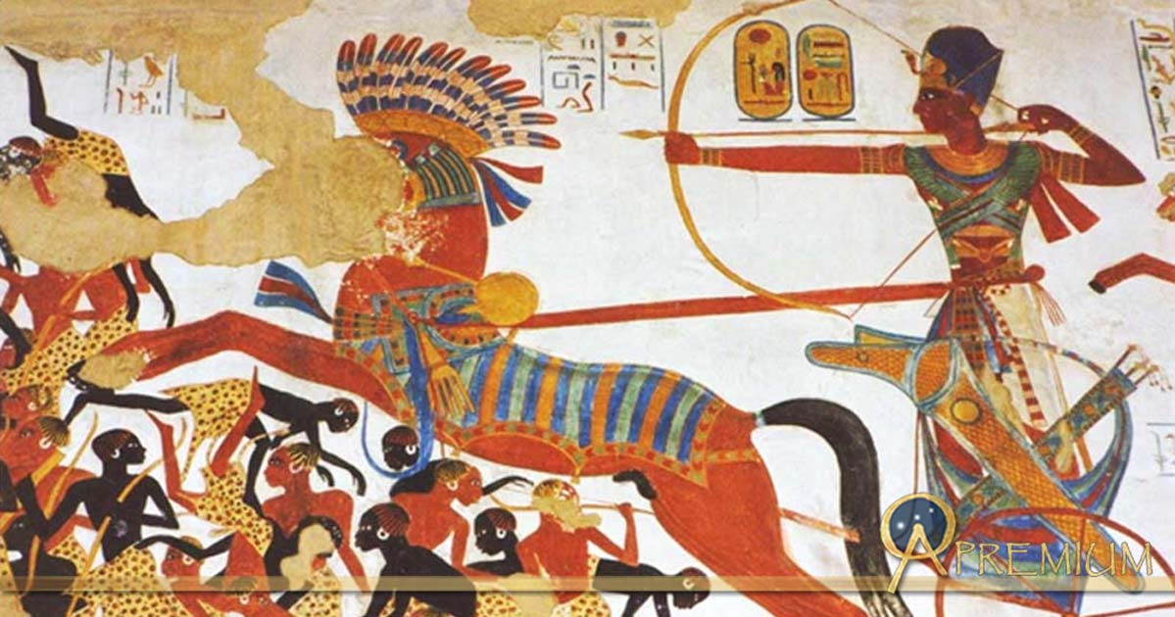
The Battle of Qadesh
C. 1274 BCE
Huge chariot battle between Rameses II’s army and the troops of the Hittite king Mutawallis II
Famous because Rameses II had it sculpted into various monuments
Both sides claimed victory

Slide 87
Egypt’s decline
From the 8th century BCE onward, Egypt fell under the control of Nubians, Assyrians and Persians
Alexander the Great’s Macedonian Greeks conquered Egypt in 332 BCE
This victory began the reign of the Ptolemies – the Greek rulers who were Egypt’s last pharaohs

Slide 88
Legacy Station Activity
Groups of 5-6
Read/Examine/Watch the information at each station and complete the graphic organizer.
You will spend approximately 8 minutes at each station
When I say switch you may switch with your group
Complete the last question on the worksheet

